Slide 1
Software Quality Assurance and Testing Technology
2nd Semester, Spring 2022
Haiming Liu
School of Software Engineering
Beijing Jiaotong University
Sunday, May 22, 2022

Slide 2
Review
Week 1: The basic concepts and theories of testing
Week 2-3: Principles of Testing
Week 4: Testing the specification
Week 5-6: Black Box Testing
Week 7-11: White Box Testing
Week 12: Integration Testing and System Testing
Week 13: Usability Testing and Accessibility Testing
Week 14: Security Testing
Week 13: Software Quality
Week 15: Review I
Week 16: Review II

Slide 3
Topics in Testing Software
Usability

Slide 4

Software Usability
Eventually a person will interact with a software system.
Software usability is how:
appropriate
functional
effective
that interaction is.
Ergonomics is the science of designing everyday things so that they are easy and functional to use.

Slide 5
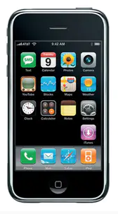
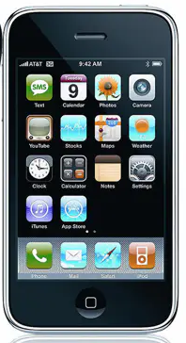
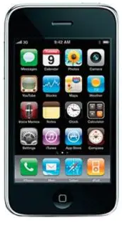
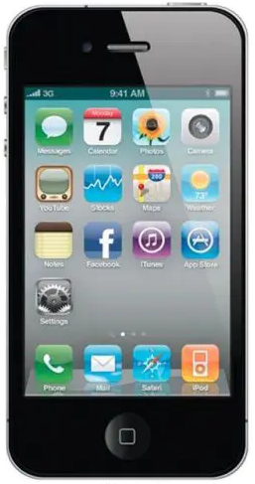
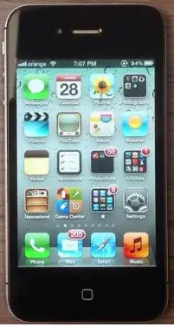
Important traits of a good UI
iOS1-2007
iOS2-2008
iOS3-2009
iOS4-2010
iOS5-2011

Slide 6
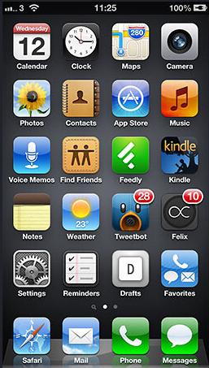
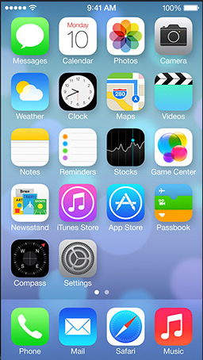
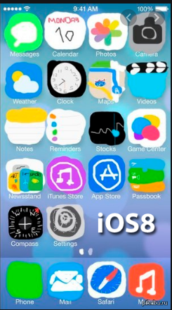
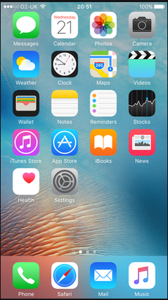
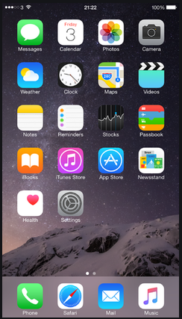
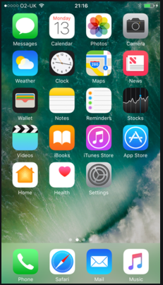
Important traits of a good UI
iOS6-2012
iOS7-2013
iOS8-2014
iOS9-2015
iOS10-2016

Slide 7
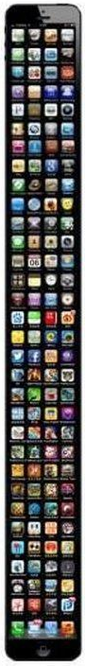
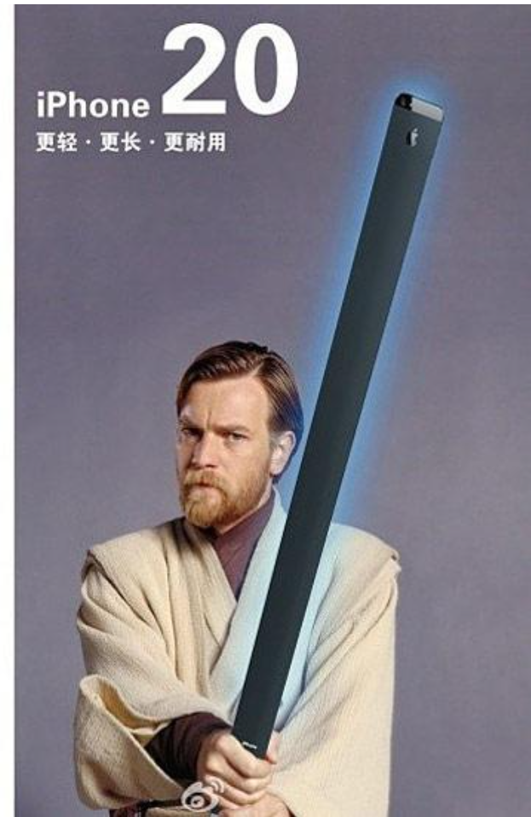
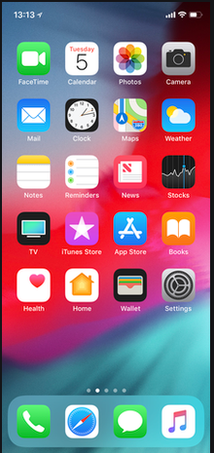
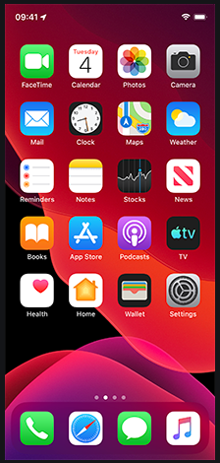
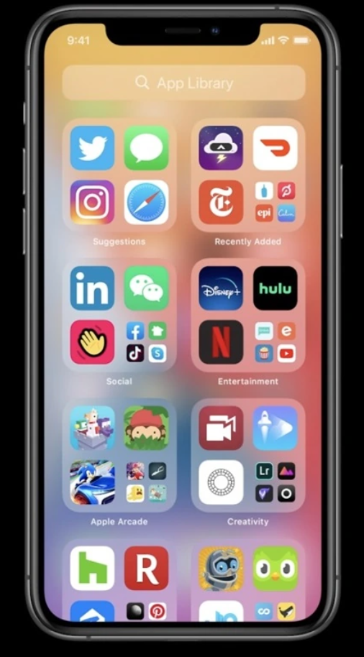
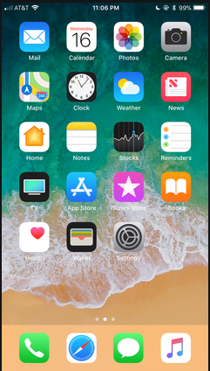
Important traits of a good UI
iOS11-2017
iOS12-2018
iOS13-2019
iOS14
iOS20?

Slide 8
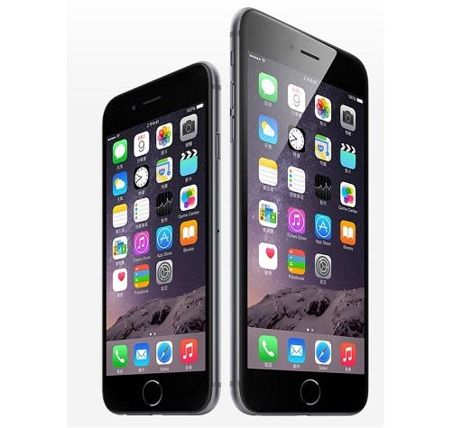
Important traits of a good UI
Follows standards and guidelines
Intuitive
Consistent
Flexible
Comfortable
Correct
Useful

Slide 9
Follows UI standards and guidelines
Macintosh Human Interface Guidelines
http://developer.apple.com/documentation/UserExperience/Conceptual/OSXHIGuidelines/XHIGIntro/chapter_1_section_1.html
Microsoft Windows User Experience
http://msdn2.microsoft.com/en-us/library/aa511258.aspx
These guides detail how software that runs on each platform should look and feel to the user.
When should a check box be used instead of a button?
When is it proper to use information, warning, or critical messages?

Slide 10
Follows UI standards and guidelines (cont’d)
The standards guidelines for a platform should be treated as an addendum to the product specification.
Test cases should be created based on the standards guidelines in addition to the test case created from the product’s specification.
If the development platform does not have a standard, the design team must create usability standards for the software itself.

Slide 11
Intuitive UI
Is the UI clean, unobtrusive, not busy?
Are responses obvious and there when you expect them?
Is the UI organized and laid out well?
Are the inputs acknowledged?
Do the menus go too deep?
Is there excessive functionality?
Is there information overload?
Does the help system really help the user?
Notes:
UI是否干净、不显眼、不忙？
反应是否显而易见，并且在你期望的时候就出现了？
UI的组织和布局是否良好？
输入是否已确认？
菜单是否太深？
是否有过多的功能？
是否存在信息过载？
帮助系统真的帮助了用户吗？

Slide 12
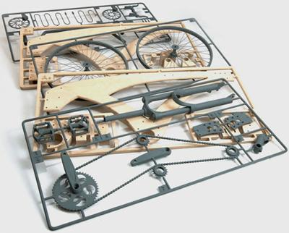
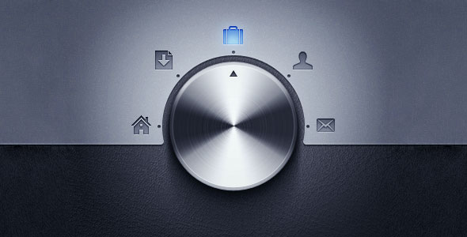
Non-intuitive UIs

Slide 13
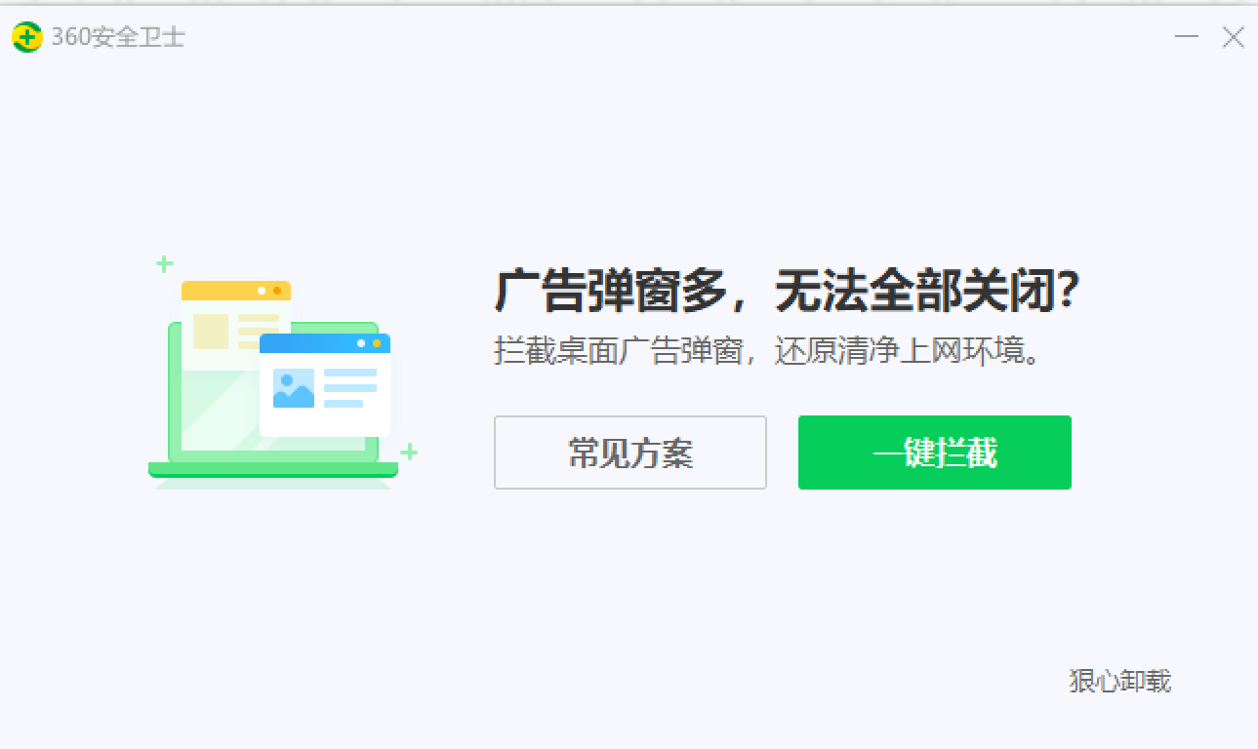
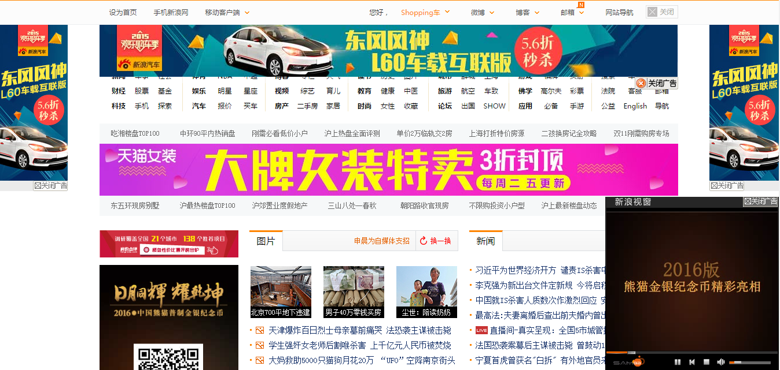
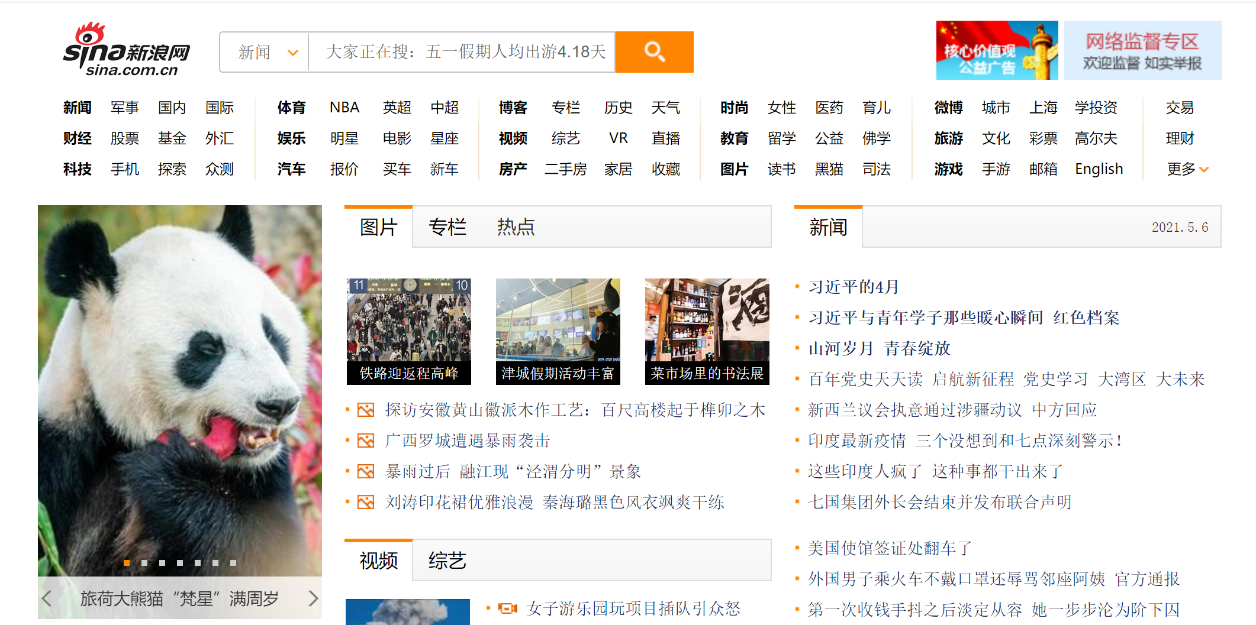
Non-intuitive UIs

Slide 14
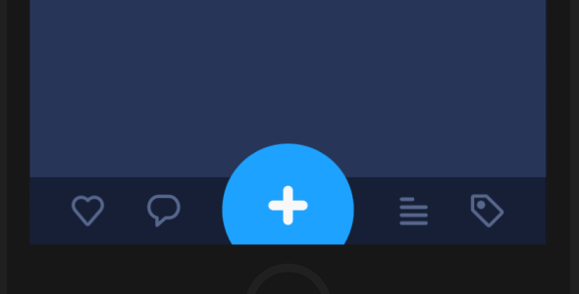
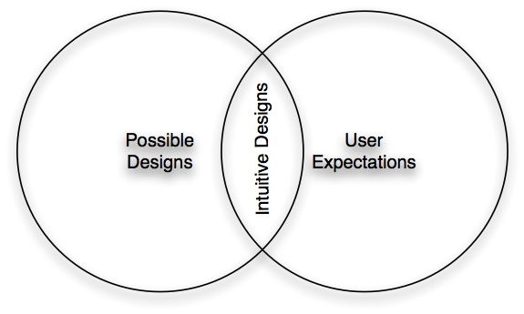
Intuitive UIs

Slide 15
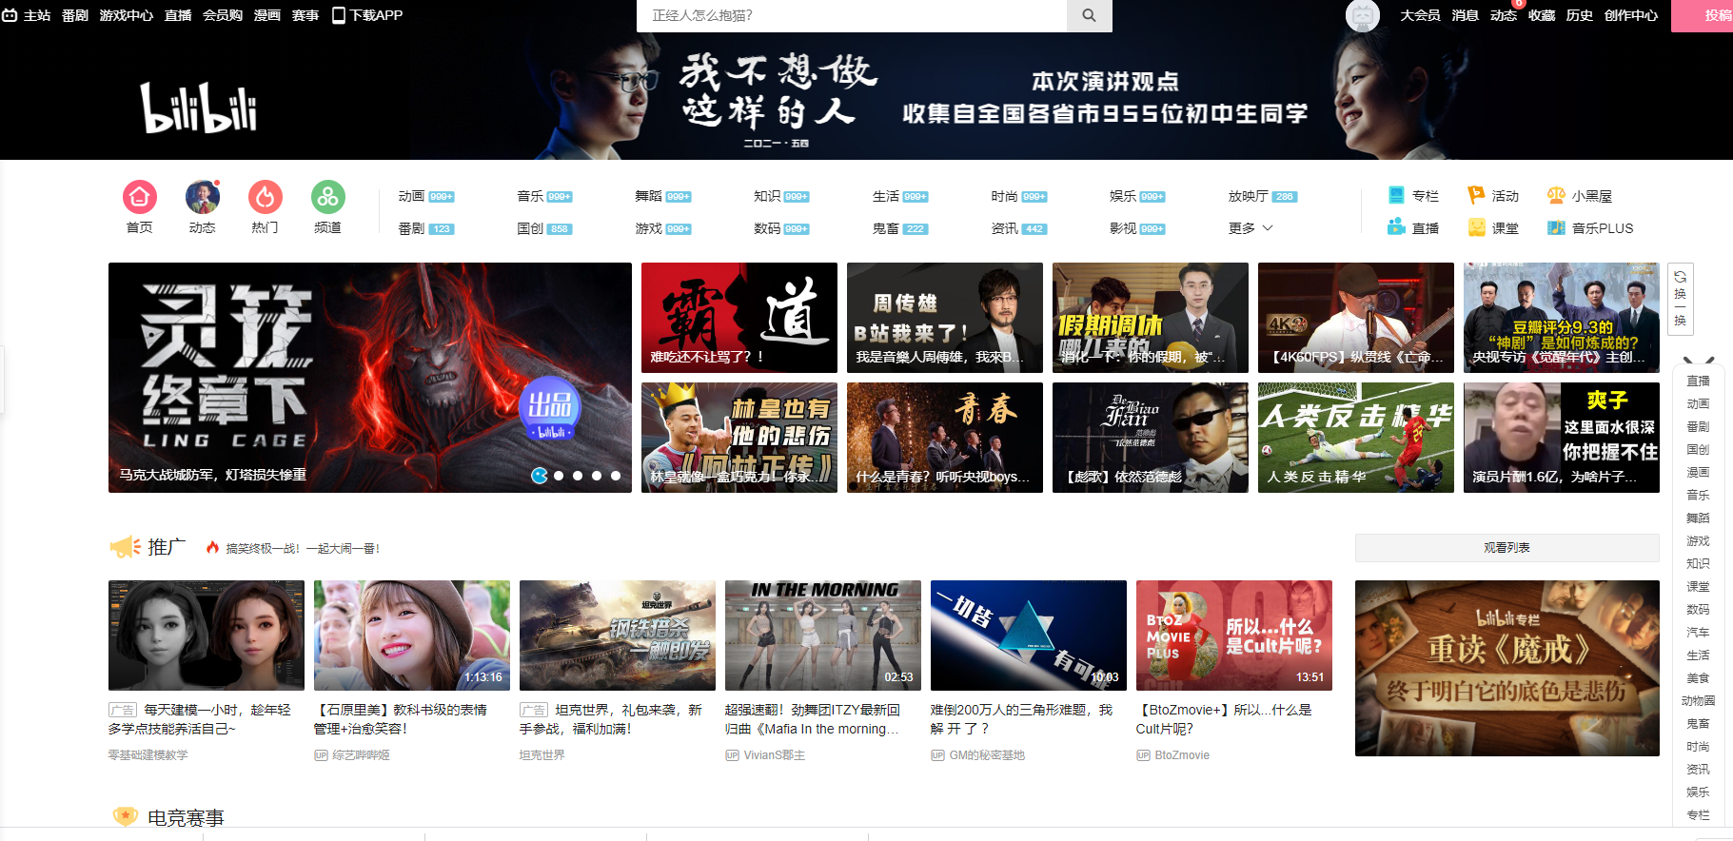
System Testing
Intuitive UIs

Slide 16
Intuitive UIs

Slide 17
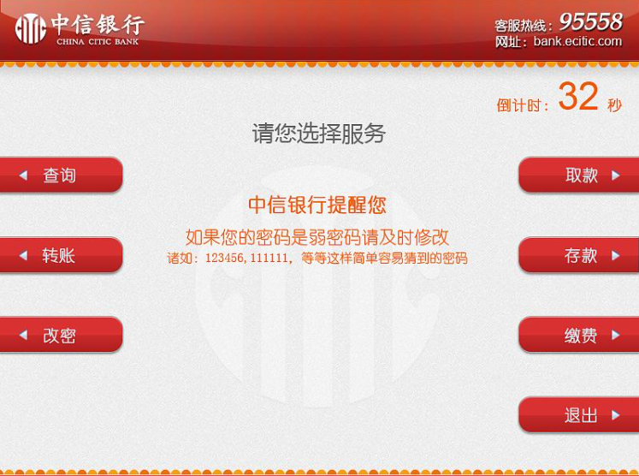
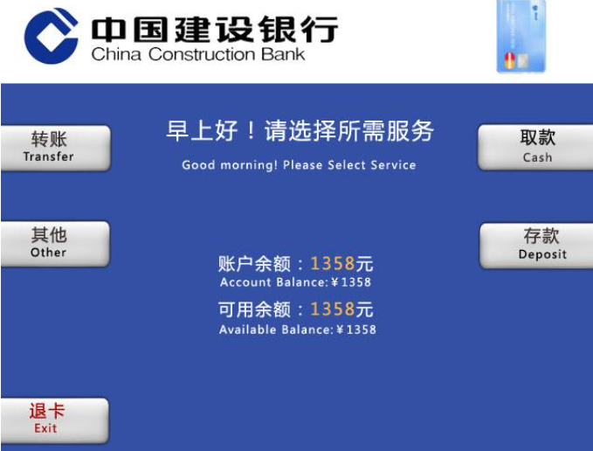
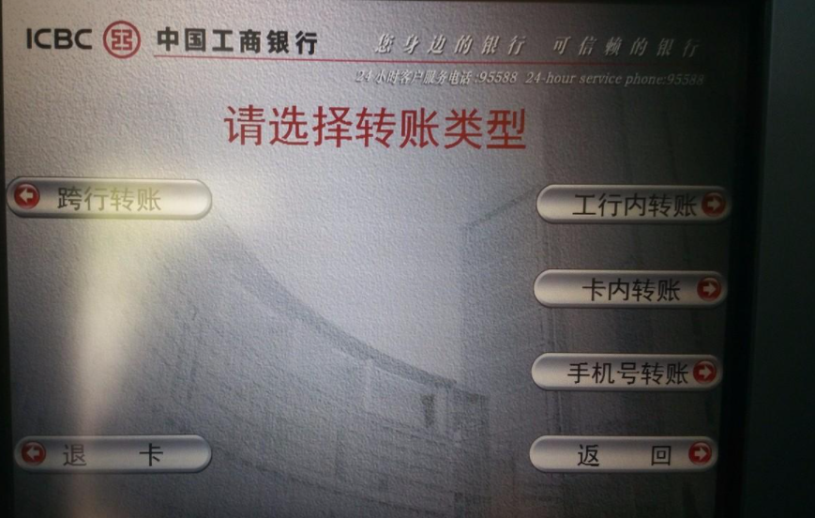
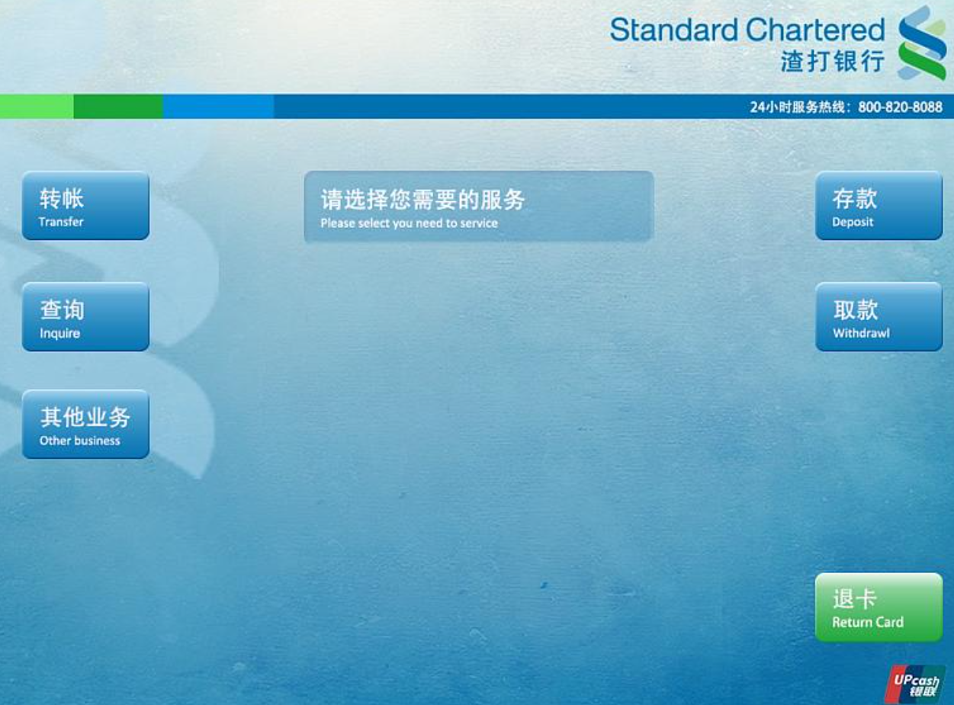
Consistent UI
Shortcut keys and menu selections
F1 should always get you Help in MS Windows.
Different UI paths should have the same F key to execute a feature.
Terminology and naming
Is Find sometimes called Search?
Audience
Consider the success of the UI of the car and ATM.
Placement of buttons such as OK and Cancel
In Mac OS, the OK button is always on the right.
In MS Windows the, the OK button is on the left and Cancel is on the right.
Notes:
快捷键和菜单选择
F1应始终在MS Windows中获得帮助。
不同的UI路径应具有相同的F键以执行功能。
术语和命名查找
有时被称为搜索吗？
观众
考虑一下汽车和ATM的UI是否成功。
按钮的放置，如“确定”和“取消”
在Mac OS中，“确定”按钮始终位于右侧。
在MS Windows中，确定按钮位于左侧，取消按钮位于右侧

Slide 18
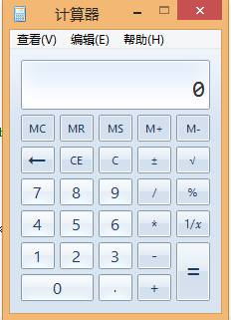
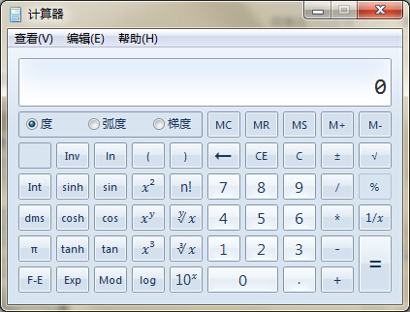
Flexible UI
Users like choices … but not too many.
E.g., MS simple and scientific calculators
Flexible UIs provide:
State jumping
Many alternative ways to achieve the same goal.
State termination and skipping
“If you know your party’s extension enter it at any time”.
Multiple ways to perform I/O
Excel allows many input formats (from keyboard or files) and many output formats (table, graphs, charts).

Slide 19
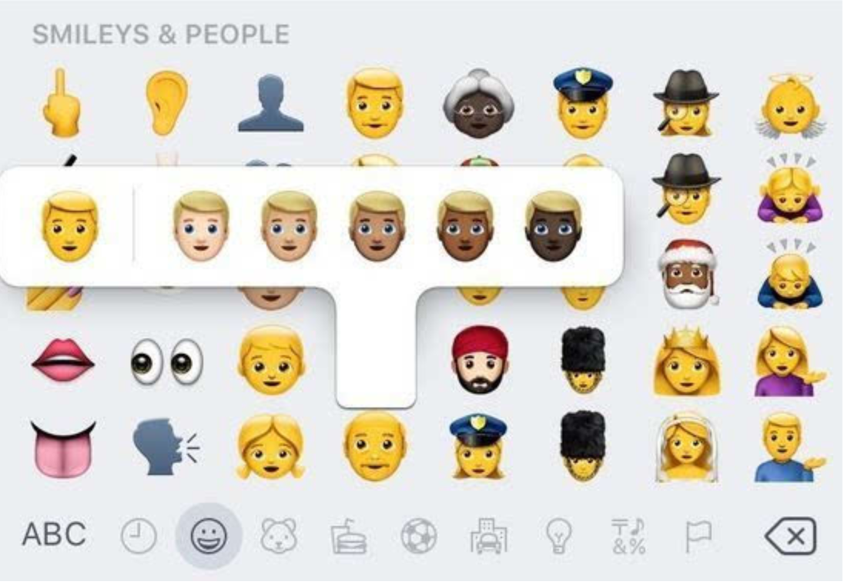
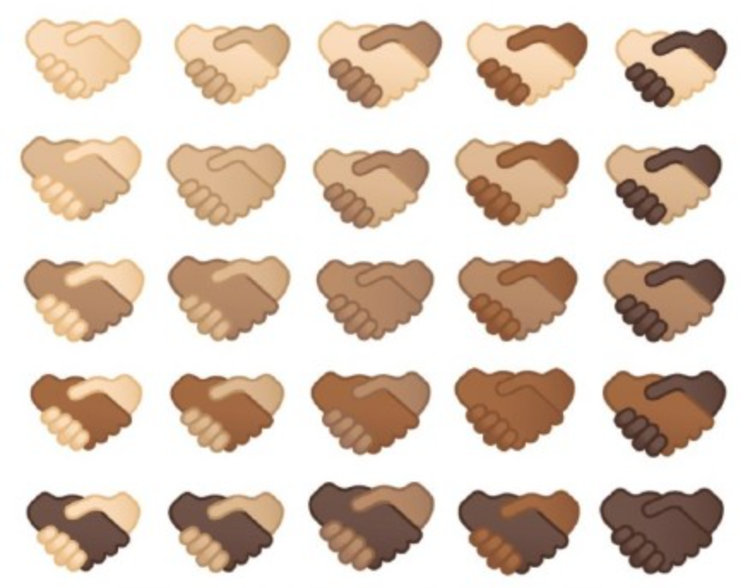
Comfortable UI
Sounds like a strange notion …
Is the UI appropriate?
Sound effects in a computer game? How about a business application?
Does the UI handle errors well?
If there is no Undo/Redo feature critical operations may fail.
Is the feedback fast enough or too fast?
E.g., waiting for cash to come out of the ATM
Does excessive use cause harm?
E.g., Emacs hand

Slide 20
Correct UI
Marketing differences
Are there extra or missing functions from what the marketing material states?
Language and spelling
Error messages often have spelling mistakes
Bad media (icons, images, sounds, videos) that for with the software UI.
WYSIWYG
E.g., does the printed Adobe Acrobat file look like the one on the screen?

Slide 21
Useful UI
When testing a UI feature, ask if the feature you see actually contributes to the software’s value.
Many applets have useless features
Useless UI features waste time for the user, developer, and tester.

Slide 22
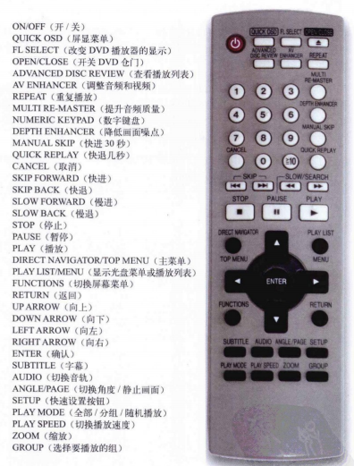
Useful UI

Slide 23
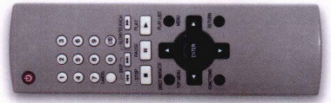
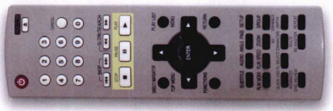
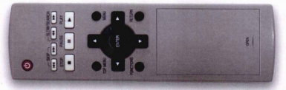
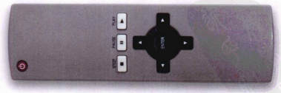
Useful UI

Slide 24
Topics in Testing Software
Accessibility

Slide 25
61 million adults in the United States live with a disability
26 percent (one in 4) of adults in the United States have some type of disability.
The percentage of people living with disabilities is highest in the South.
Percentage of adults with functional disability types:
13.7 percent of people with a disability have a mobility disability with serious difficulty walking or climbing stairs.
10.8 percent of people with a disability have a cognition disability with serious difficulty concentrating, remembering or making decisions.
6.8 percent of people with a disability have an independent living disability with difficulty doing errands alone.
5.9 percent of people with a disability are deaf or have serious difficulty hearing
4.6 percent of people with a disability have a vision disability with blindness or serious difficulty seeing even when wearing glasses.
3.6 percent of people with a disability have a self-care disability with difficulty dressing or bathing.

Slide 26
Accessibility Testing (testing for the disabled)
The following impairments make using computers especially difficult:
Visual
E.g., color blindness, tunnel vision, cataracts.
Hearing
E.g., partial or complete deafness.
Motion
E.g., injury can make using a keyboard or mouse difficult or impossible.
Cognitive and language
E.g., dyslexia or memory problems and using complex UIs

Slide 27
Legal requirements
In the US, three laws apply to developing software with a UI that can be used by the disabled:
The Americans with Disability Act (ADA) has been applied to commercial Internet websites.
Section 508 of the Rehabilitation Act is similar to the ADA and applies to any organization that receives federal funding.
Section 255 of the Telecommunications Act requires all hardware and software that transfers information over the Internet/network/phone line be accessible to people with disabilities.
Notes:
在美国，有三条法律适用于开发具有可供残疾人使用的UI的软件：
《美国残疾人法案》（ADA）已适用于商业互联网网站。
《康复法案》第508节与《美国残疾人法案》类似，适用于任何接受联邦资助的组织。
《电信法》第255条要求残疾人可以使用通过互联网/网络/电话线传输信息的所有硬件和软件。

Slide 28
Accessibility features in software
If the software being tested does not run on a platform that has specified accessibility features?
Accessibility features will have to be specified, programmed, and tested.
If your platform has built in accessibility features your software?
Software only needs to adhere to the platform’s standard for communicating with peripheral devices.
Remember to create test cases specifically to test for accessibility.
Add them to your configuration testing equivalence partitions.

Slide 29
Microsoft Windows accessibility features
Sticky-keys: Allow Shift, Ctrl, Alt keys to stay in effect until the next key is pressed.
Filter-keys: prevents brief repeated keystrokes from being recognized.
Toggle-keys: plays tomes when Caps Lock, Scroll Lock, or Num Lock keyboard modes are enabled.
Sound-sentry: creates a visual warning whenever the system generates a sound.
Show-sounds: instructs program to display captions for any sounds or speech they make.

Slide 30
Microsoft Windows accessibility features (cont’d)
High contrast: sets up the screen with colors and fonts designed to be read by the visually impaired.
Mouse-keys: allows the use of keyboard keys instead of he mouse to navigate.
Serial-keys: sets up a communication port to read in key strokes from an external (non-keyboard) device.

Slide 31
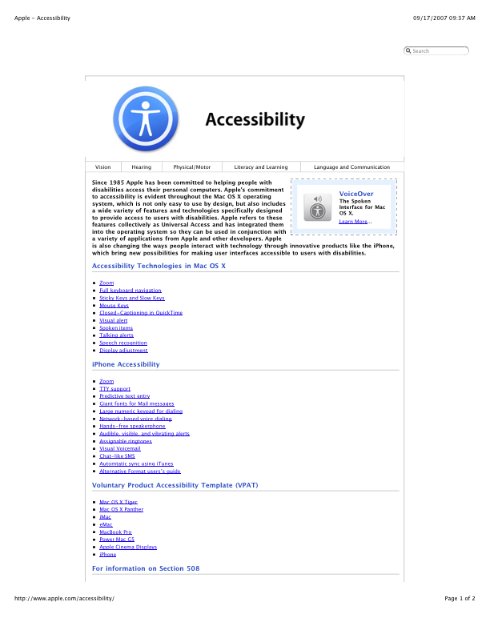
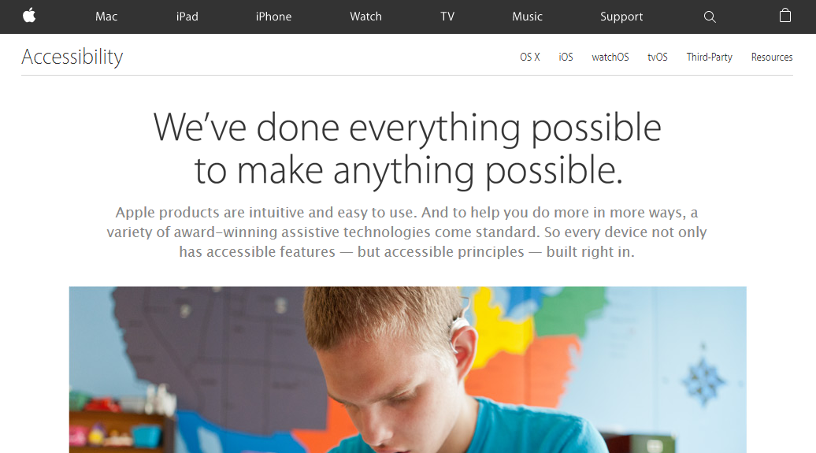
System Testing
Apple’s accessibility website

Slide 32
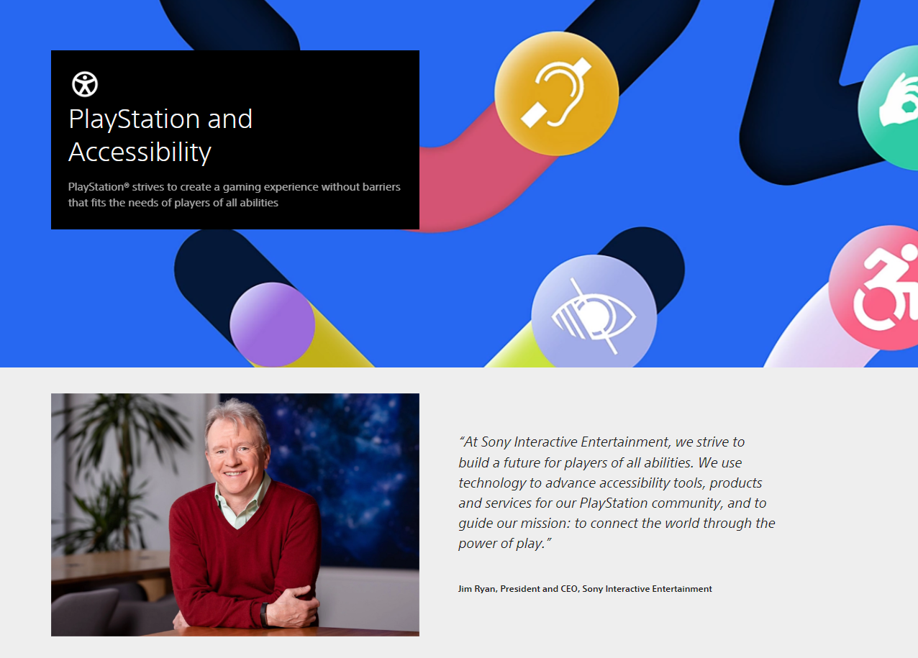
Playstation’ accessibility website

Slide 33
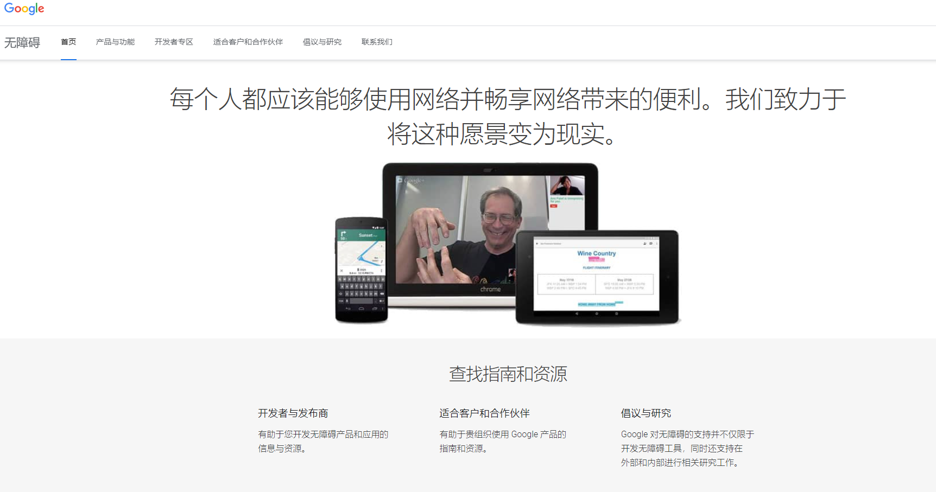

Slide 34
To be continued… See you next week

